Slide 1
RECOMMENDATION SYSTEM FOR FARMERS
Guided By:
Mr. J.MATHALAIRAJ M.E.,(Ph.D).,
Team Members:
Dharshanapriya V 921019104012
Janani Priya M 921019104020

Slide 2
Abstract:
Agriculture is the most important sector in today’s life. So we need to plant the suitable crop for the suitable atmosphere with proper fertilizer. And also most of the plants are affected by a wide variety of bacterial and fungal diseases. Diseases on plants placed a major constraint on the production and a major threat to food security. Hence, early and accurate identification of plant diseases is essential to ensure high quantity and best quality.An system is introduced to recommend the suitable crop for the suitable atmosphere with proper fertilizer and also it will identify the different diseases on plants by checking the symptoms shown on the leaves of the plant.

Slide 3
Literature Survey:
SI.No | Title | Author | Year | Disadvantage
1 | A Machine Learning-based Approach for Crop Yield Prediction and Fertilizer Recommendation. | Jeevaganesh R,Harish D, Priya.B | 2020 - 2021 | The accuracy of the yield prediction and fertilizer recommendation is low
2 | Plant Disease Detection Using Machine Learning. | Shima Ramesh; Ramachandra Hebbar; Niveditha; | 2021 - 2022 | The project may not be able to detect all types of plant diseases, and some diseases may require additional testing or manual inspection to diagnose accurately

Slide 4
EXISTING SYSTEM:
Focuses on plant diseases that are affected by climatic causes in specific country. Accordingly, they state that system should have an application which can operate for specific disease diagnosis using rule based model of data mining technique.
Disadvantages:
They only focus for the specific location
The accuracy of disease detection and diagnosis depends heavily on the availability and quality of data used to train the machine learning algorithms. If there is limited data available or the data quality is poor, the predictions may not be accurate

Slide 5
Proposed System:
The crop, fertilizer recommendation, and disease prediction project using AI domain is a system designed to assist farmers in making more informed decisions about their crop production.
In Disease Prediction module we use CNN Algorithm to achieve the accurate Prediction of the image. This module will explain about the disease and also give some prescription for the problem
According to the Crop Recommendation module we use Random Forest Algorithm to recommend the suitable crop for the user selected location. It will fetch the current weather condition by using open Api. By using the present weather condition we can able to recommend the suitable crop for that location
In Fertilizer Recommendation module, we take inputs such as the crop name, nitrogen, phosphorous, and potassium levels in the soil, and then recommends a suitable fertilizer to be used. It does this by comparing the user's input values with the standard values for the given crop from a pre-defined dataset.

Slide 6
Advantages:
A recommendation system can help farmers reduce their expenses on inputs such as fertilizers, pesticides, and water by recommending the most efficient and effective use of these resources
A recommendation system can help small-scale farmers compete with larger farming operations by providing them with access to the same technology and expertise, allowing them to make more informed decisions and improve their yields and profits
Improve the efficiency of the Farming

Slide 7
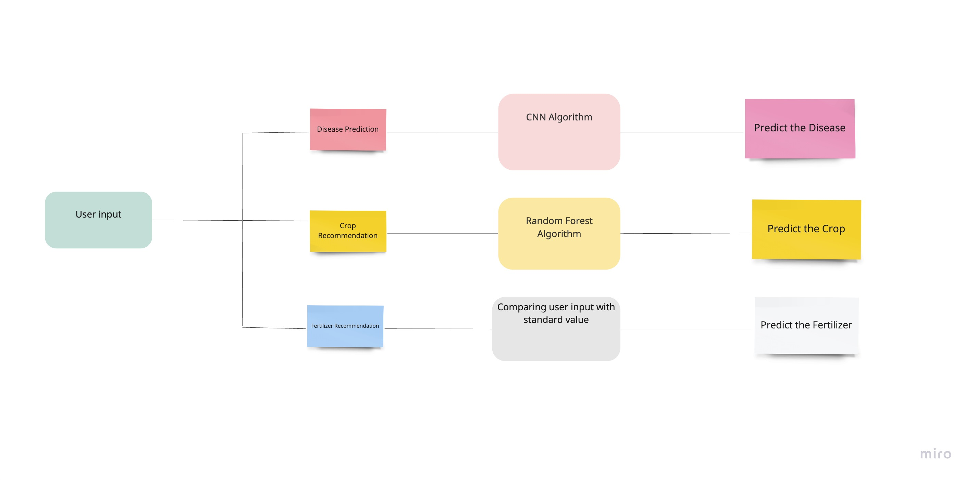
System Architecture

Slide 8
Modules:
Disease Prediction
Crop Recommendation
Fertilizer Recommendation

Slide 9
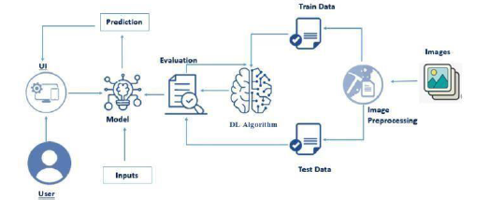
Module Description:
Disease Prediction:
The disease prediction module uses a pre-trained deep learning model, to classify plant diseases based on images of plant leaves.
The model has been trained on a dataset containing images of different plant species with various diseases. The available disease classes are listed in the 'disease_classes' variable. The model is trained by using CNN Algorithm

Slide 10
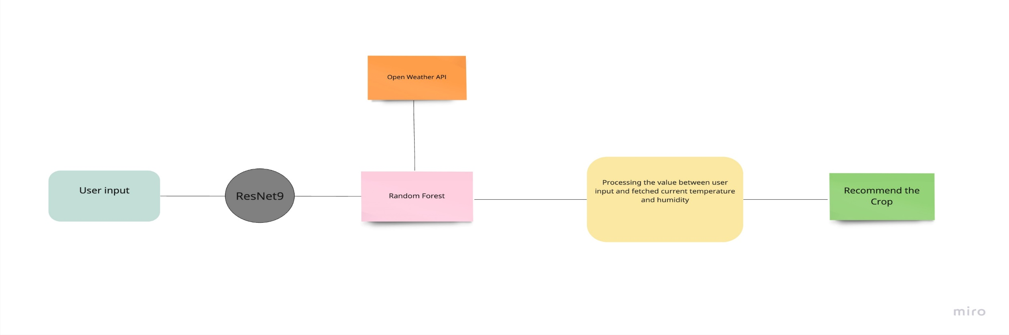
Crop Recommendation:
The crop recommendation model use Random Forest algorithm that takes in various input parameters related to soil and weather conditions, and predicts the most suitable crop for the given conditions.
The model is trained on a dataset containing information about different crops, such as their nitrogen, phosphorous, and potassium requirements, pH tolerance, and water requirements
It will fetches the current temperature and humidity of the city using the OpenWeatherMap API for present temperature of the user give city

Slide 11
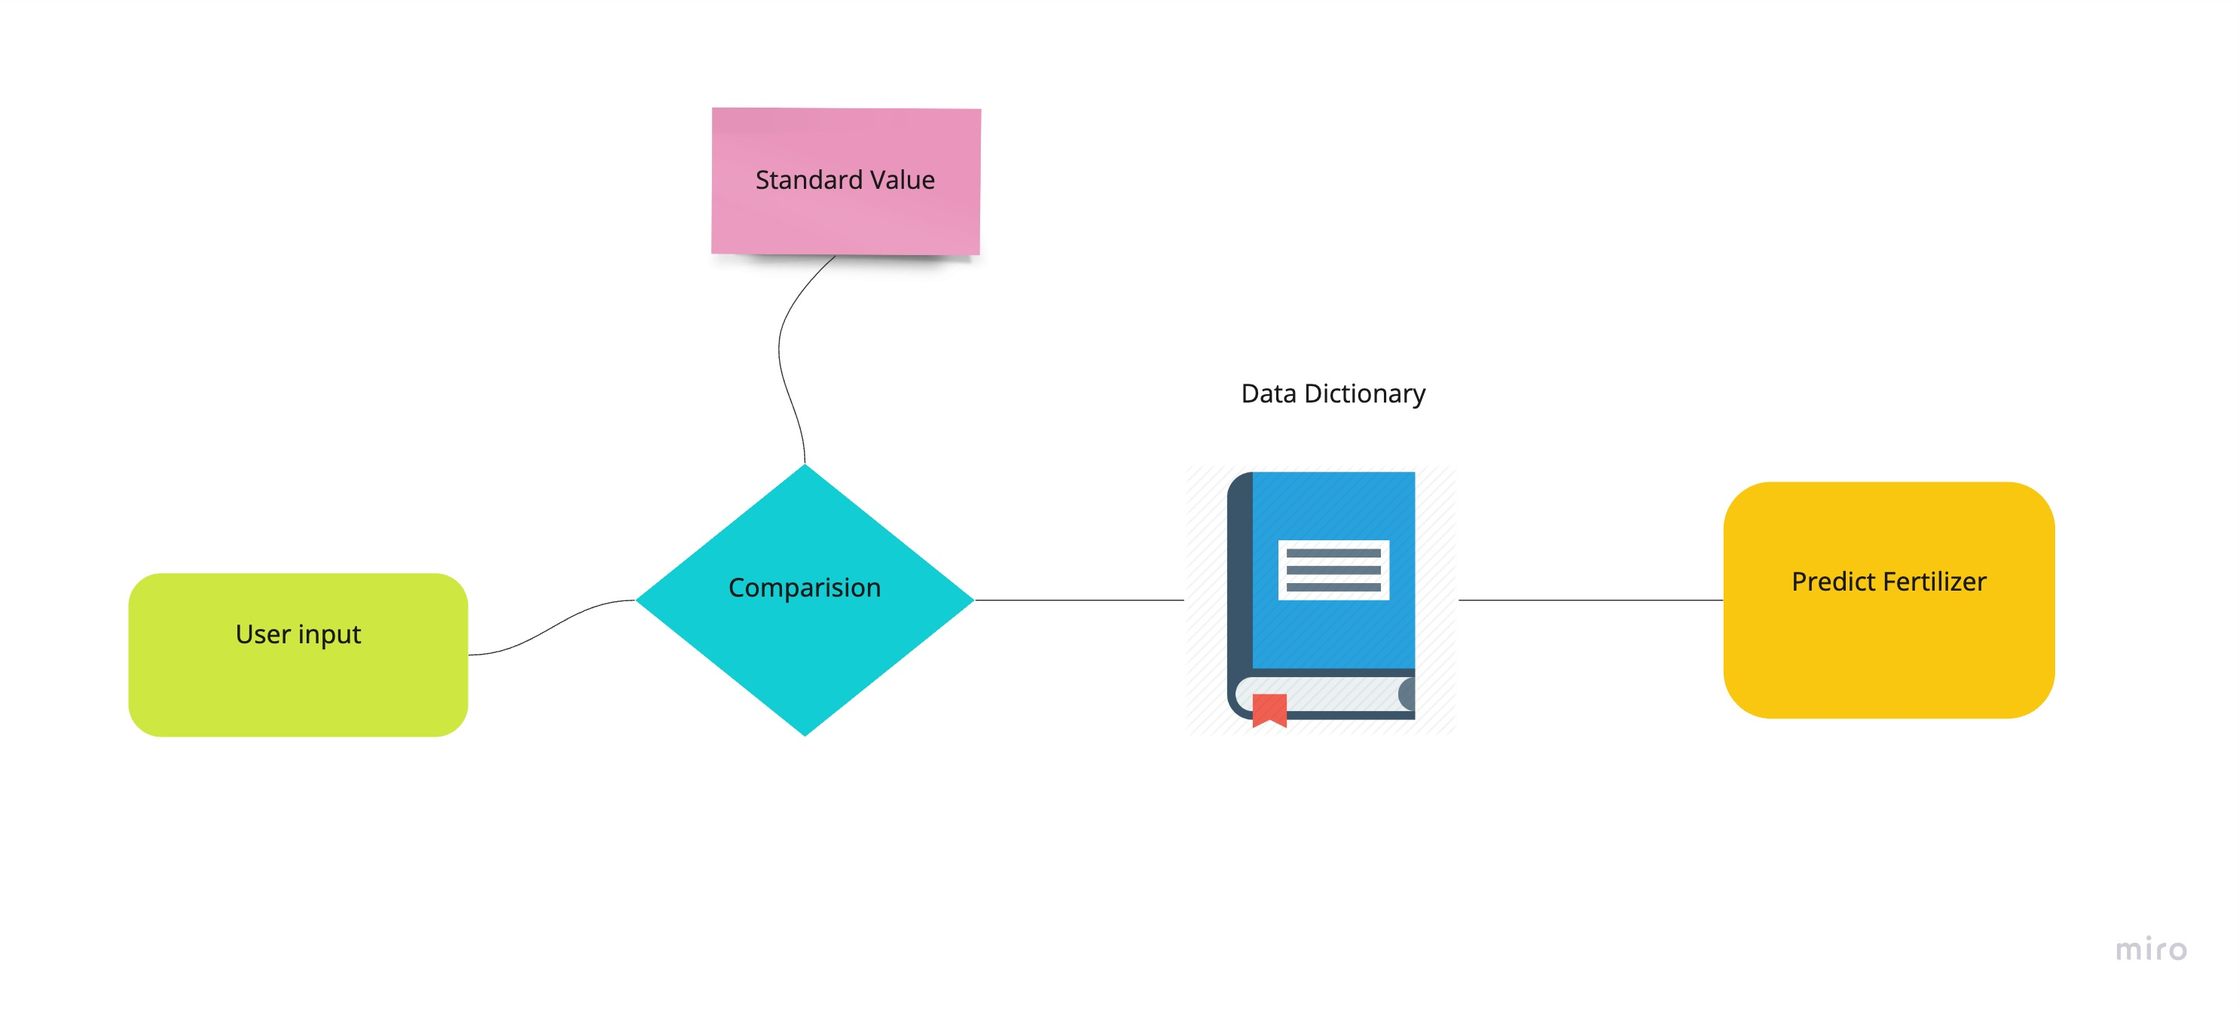
Fertilizer Recommendation:
The fertilizer recommendation function takes inputs such as the crop name, nitrogen, phosphorous, and potassium levels in the soil, and then recommends a suitable fertilizer to be used.
It does this by comparing the user's input values with the standard values for the given crop from a pre-defined dataset.
Based on the differences between the user's input and the standard values, the function determines which nutrient (N, P, or K) is deficient or in excess and recommends a fertilizer accordingly

Slide 12
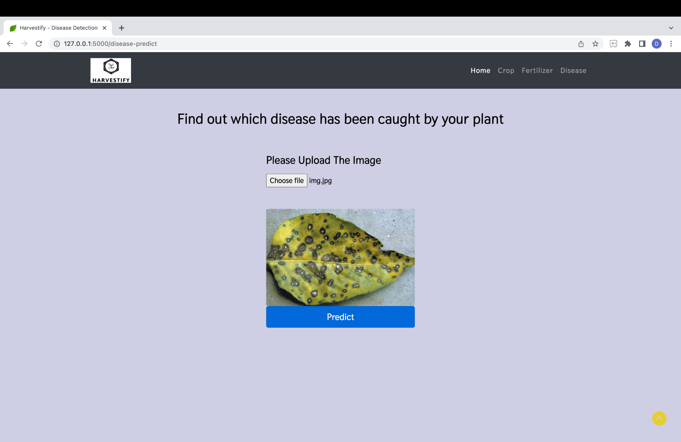
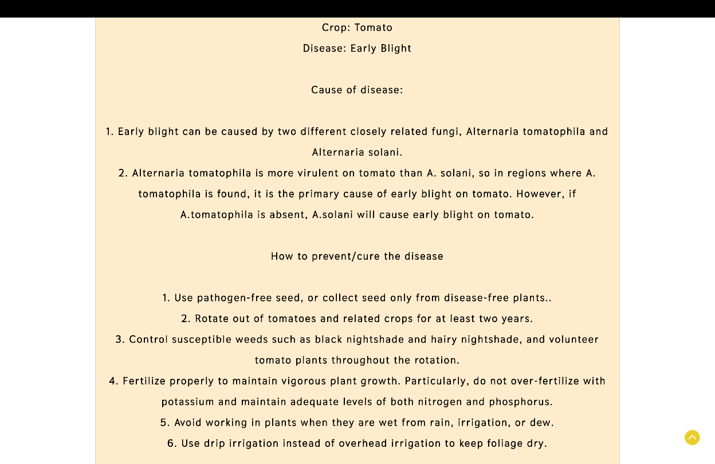
Output for Disease Prediction:
Input
output

Slide 13
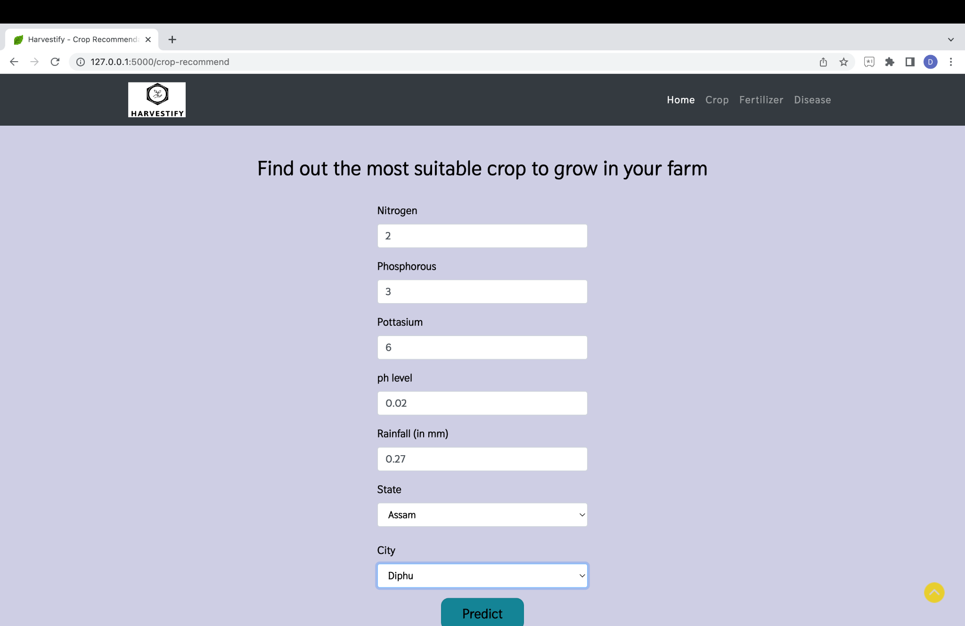
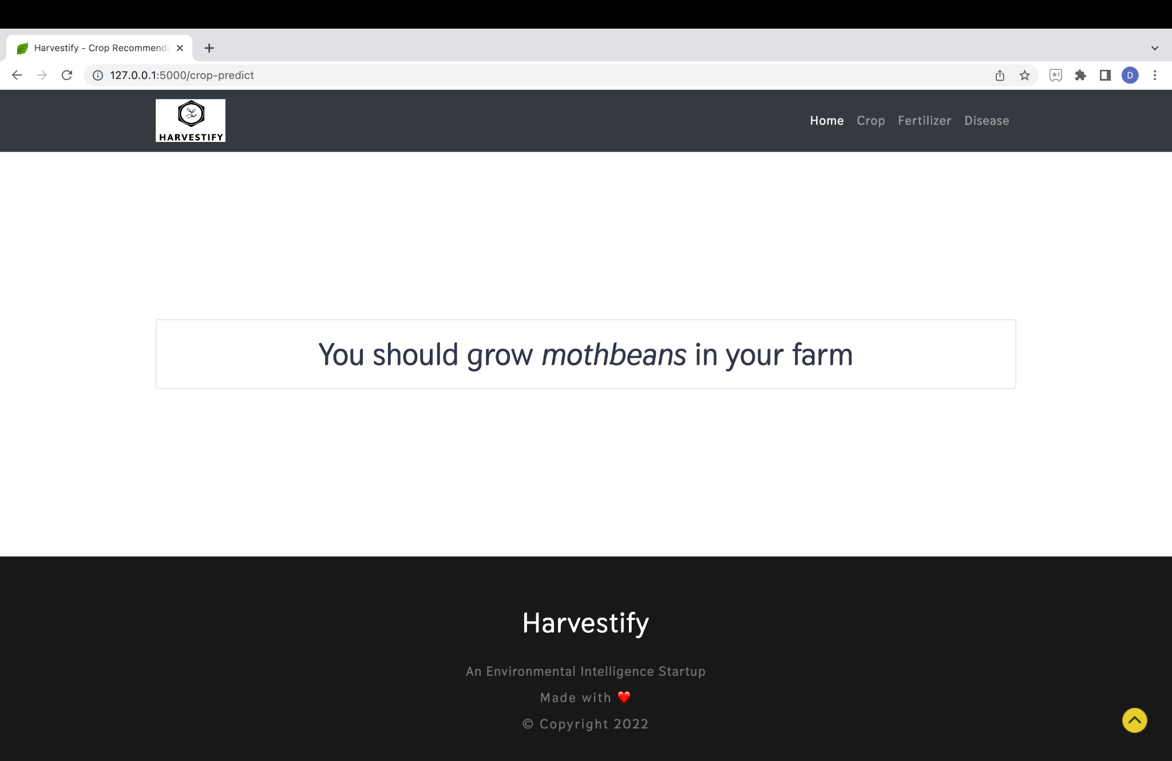
Output for Crop Recommendation:
Input
Output

Slide 14
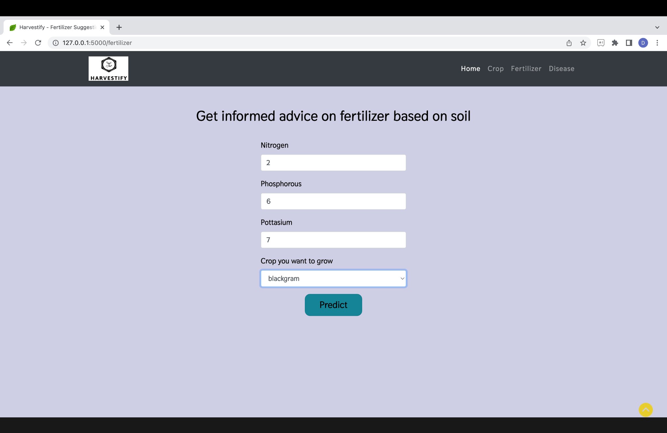
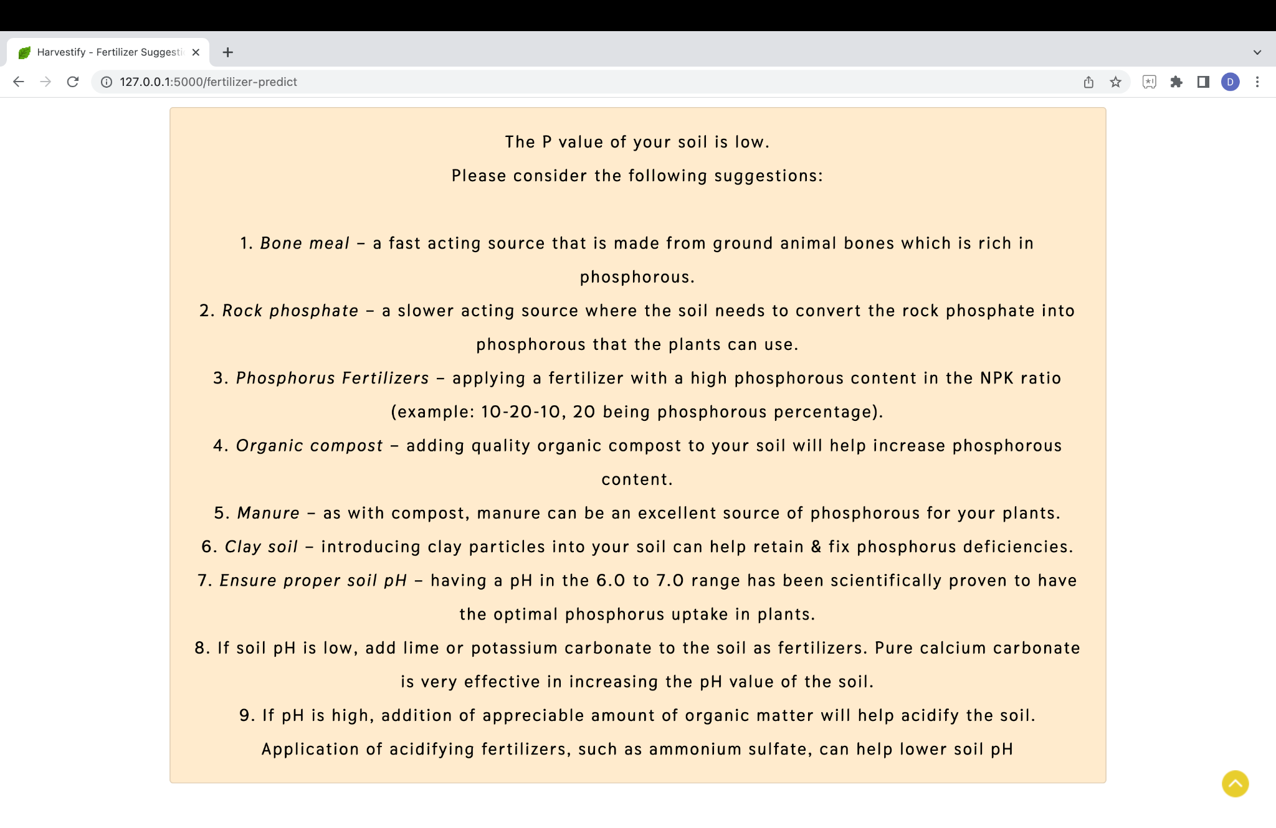
Output for Fertilizer Recommendation:
Input
Output

Slide 15
Conclusion:
In conclusion, the recommendation system for farmers that involves crop recommendation, fertilizer recommendation, and disease prediction has significant potential to revolutionize the agriculture industry. By utilizing machine learning this system can provide farmers with accurate and personalized recommendations for crop selection, fertilizer application, and disease prevention

Slide 16
Future Enhancement:
The recommendation system could be enhanced by incorporating economic factors such as market demand and prices. This could help farmers make more informed decisions about crop selection and production planning.Partnering with local agricultural agencies could provide the recommendation system with access to more data and resources. This could help improve the accuracy of recommendations and ensure that they are tailored to the specific needs of local farmers. The recommendation system could be integrated with precision agriculture technologies, such as drones and sensors, to provide farmers with real-time data about their crops. This could help improve the accuracy of recommendations and make them more responsive to changing conditions.

Slide 17
References:
[1] Semi-automatic leaf disease detection and classification system for soybean
culture IET Image Processing, 2018
[2] Cloud Based Automated Irrigation And Plant Leaf Disease Detection System
Using An Android Application. International Conference on Electronics,
Communication and Aerospace Technology, ICECA 2017.
[3] Ms. Kiran R. Gavhale, Ujwalla Gawande, Plant Leaves Disease detection
using Image Processing Techniques, January 2014.

Slide 18
Thank You

